Slide 1


Extra Care Recommissioning Project (ECRP)
Market Event 30th/31st January 2024

Slide 2
Introduction and Welcome
Andrea Bushell – Service Manger Commissioning & Performance
andrea.bushell@westnorthants.gov.uk
Lisa Waggott - Commissioning and Quality Outcomes Manager
lisa.waggott@westnorthants.gov.uk

Slide 3
Aim of today
Budget update…
Today we hope to cover the following information:
▪ Current provision
Broad outline of the proposed model
Indicative timelines for the recommissioning of care and support
Estimated volumes of activity within West Northamptonshire
Quality Improvement offer
How you can register to tender and prepare for the recommissioning
Questions

Slide 4
What are we not discussing (and why)….
We will not be commenting on;
Fee Levels – Decisions on future fees are under discussion and yet to be confirmed.

Slide 5
Current Demand
WNC is funding care and support to around people ​: 75
This equates to approximately: 1,098.5 per week
​
Total spend on Care and Support within Extra Care is c. £1,166,867 per annum​

Slide 6
Current Provision – Balmoral Place
Budget update…
Scheme 1 –
Balmoral Place : Kingsthorpe, Northampton, Northamptonshire, NN2 6LA
Landlord: Plexus UK Limited : ( LEASE HOLDER ) Mears UK ( MANAGING AGENT )
80 self-contained 1 bedroom apartments for over 55s
24 hour emergency alarm response service
24/7 On-site services and support
Access to affordable rent for all
Mears housing Management is responsible for the day to day running and maintenance of the scheme.
Number of weekly hours currently commissioned is 523 (38 customers)

Slide 7
Current Provision - Foxfields
Scheme – 2
Foxfields : Upton, Northampton, Northamptonshire, NN5 4FR
Landlord: Housing 21
77 self-contained 1 and 2 bedroom apartments for over 55s
24 hour emergency alarm response service
24/7 On-site services and support
Access to affordable rent for all
Housing 21 housing Management is responsible for the day to day running and maintenance of the scheme.
Number of weekly hours currently commissioned is 401.5 (26 customers)

Slide 8
Current Provision – St Crispins
Scheme - 3
St Crispin’s Retirement Village : Upton, Northampton, Northamptonshire, NN5 4RA
Landlord: Midland Heart
270 self-contained 1- and 2-bedroom apartments and bungalows for over 55s
24-hour emergency alarm response service
24/7 On-site services and support
Access to affordable rent for all
Midland Heart housing Management is responsible for the day to day running and maintenance of the scheme.
Number of weekly hours currently commissioned is 174 (11 Customers)

Slide 9
Feedback and Engagement
Budget update…
Engagement undertaken to date:
Benchmarking
Resident's surveys
Residents & carers meetings
External Stakeholders
Internal stakeholders
Provider engagement
Feedback themes:
Home for life
Safety
Independence/ having own space/ live my own life
Social interaction/activities
Peace of mind knowing someone is able to help when needed
Provides assurance to family and friends
Identified need for improved training
Continuity of staff/staff availability
Communication

Slide 10
Proposed Model
Overarching Framework
Contract duration 5 years with option to extend by two individual 12-month periods
3 Lots associated to the three individual schemes
Removal of the age restriction of 55+
Outcomes focussed
WNC seek to invest in this model over the life of the contract
Fee model:
Core & 1:1
Other models?

Slide 11
Indicative Timelines ….
Anticipated timelines
Publication: March 2024
Submission date: April 2024
Contract Award: June 2024
Mobilisation: June 2024
Contract Start date: 1st September 2024

Slide 12
Quality Assurance
Budget update…
As a Framework Provider you can expect:
A dedicated and experienced Contract Monitoring Officer to support your service
Welcome visit as a new service provider to explain the expectations of the council and their customers
A full monitoring visit annually to identify areas where support may be required, if required
An action plan that Contract Monitoring Officers (CMO) will work through with your service to provide support in identified areas and timescales for improvement
Experienced team with lived experience of working in and managing services commissioned by WNC and knowledge of services to be commissioned

Slide 13
How do you Tender….
To continue or to work with West Northamptonshire Council under these new arrangements, you will have to apply to be on our new Framework that will become active around spring-2024.
If you are unsuccessful in securing a place on the Framework, you will not be able to acquire any new work with WNC until we advertise the contract opportunity again.
We are aiming to advertise the opportunity in early March, through our Procurement Portal “InTend”.
All Providers will be required to be signed up to InTend our Procurement Portal In-Tend Electronic Tendering Site - Home (in-tendhost.co.uk)
We advise that all interested providers register on InTend now, in preparation for the opportunity coming out. Registration is simple and takes around 10 minutes
In-Tend can also be contacted on – Tel: 0845 557 8079 or email: support@in-tend.co.uk
WNC Procurement can also be contacted via email at procurement@westnorthants.gov.uk

Slide 14
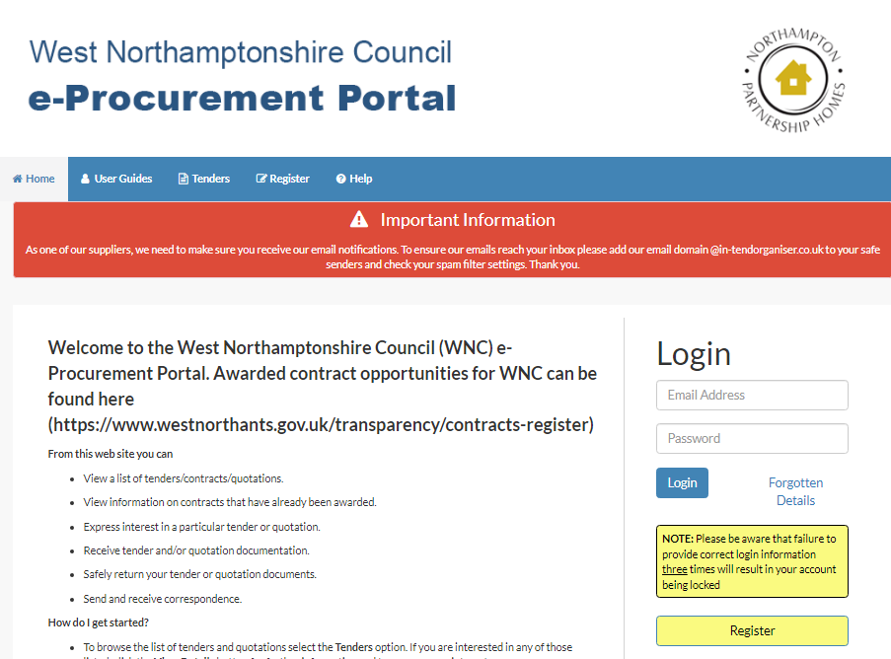
Procurement Process
Once registered you will be able to browse all of the opportunities that WNC is currently advertising, you can also set up alerts for areas that you are particularly interested in such as Social care opportunities, so that you get emails telling you when something new is being advertised.

Slide 15
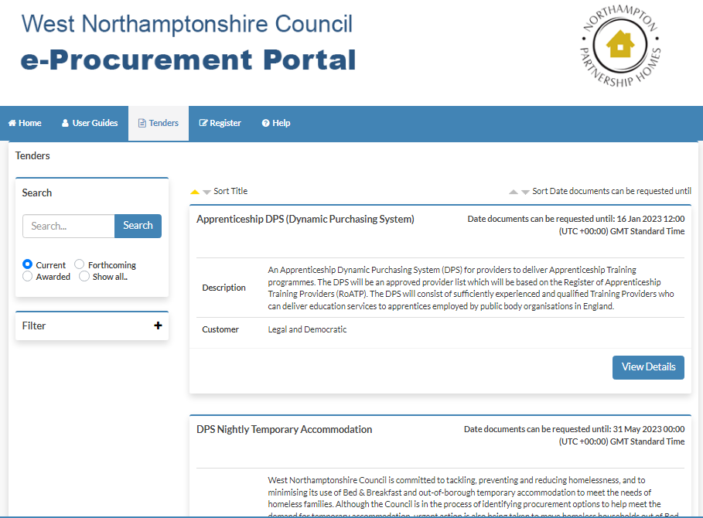
Procurement Process Cont.
Budget update…

Slide 16

Questions….
If you would like to provide further feedback, then please email:
WNCCommissioning@westnorthants.gov.uk

