Slide 1
T1085 Research into common rail health environments and roles, and their impacts on employees’ health and wellbeing
Darryl Hopper
Supplier Day

Slide 2
Agenda
Setting the scene 15mins
Intros and about the session
Why are we here
Project Overview
Group discussion 60mins
1-2-1 sessions with suppliers 90mins (30min overrun)
Open floor / AOB 15mins

Slide 3
Introductions and about this session
Welcome to all
Different sectors, different roles, potential suppliers
About this session
What matters to stakeholders, what can add value and managing expectations, refining discussions with suppliers
Outputs of the session – an informal discussion about improving the specification, next version of specification

Slide 4
Why are we here?
ORR report to industry
Complexity of managing health risks
Roadmap
An opportunity to show what can be done
Suppliers
Putting HEALTH in Health and Safety, raising awareness of Occupational Health
Notes:
ORR. (2010). Overview of work related ill health in the GB rail
industry 2010 - June 2011. London: ORR
In its overview of ill health the ORR (2010) undertook a baseline
survey of 52 rail industry constituents for the sample period 1 April
2009 to 31 March 2010
Complexity – cause and effect, multiple causes, difficulty to observe and measure, urgency/will power lost due to latency

Slide 5
Project Overview
The industry is seeking new knowledge to better manage health risks. We:
Seek to create new knowledge around 5 to 7 health hazards found within the rail environment.
Offer useful controls to be based on this new knowledge
Use the knowledge gained to create a prototype health assessment matrix where additional surveillance or assessment is a part of the controls identified.
We are looking for a supplier to identify hazards for research with reference to:
Complexity of risk assessment should be beyond expertise held within rail companies
Transferability of the findings should be across a number of companies
Most likely beneficial impact from findings (to individual health and change of controls)

Slide 6
About the Specification
Core Requirement | Additional option (a) | Additional Option (b)
Seek to create new knowledge around 5 to 7 health hazards found within the rail environment. Offer useful controls to be based on this new knowledge Use the knowledge gained to create a prototype health assessment matrix | Includes core option but with additional work to include: Extra detail and expertise is used to set out amended or create new roles/categories for the prototype health assessment matrix Existing rail specific research into health hazards to be used to create additional information for the prototype health assessment matrix | Additional key health hazards to be researched (within this option we are looking for the price to be an incentive to review additional health hazards).
Stage Gate approach - 2 hazards first

Slide 7
Discussion
What do we think the key hazards are?
How should we decide the most likely beneficial impact from the hazards put forward?

Slide 8
Work on Health Hazards by industry
Category Hazard | Projects undertaken
Chemical | Northern Rail research into Radon
Physical | T315 (EMR) T515 (Effects of Physical Agents – vibration / noise) Welding on Network Rail Ballast Dust Working Group
Biological | T051 (Toilet Waste) T385 (Human and livestock body parts) T985 (Legionella)
Psychosocial | T059 (Fatigue - train drivers) T138 (PTSD – Post Office) T317 (Minimise impact of suicide on drivers) T699 (Fatigue – freight drivers) T703 (Reduce tension and potential conflict)
Ergonomic | T940 (MSD risk) TOCs struggling with risk assessments for handling ramps etc; expert input already provided by ORR & HSE
Notes:
T315 A review of operational procedures that may expose staff to EMF
T515 Vibration and noise consultation response
T051 Level of health risk from discharge shown to be low
Practical measures to further reduce likelihood of infection identified
T385 Concerns regarding the potential health risks to staff arising from contact with human or livestock remains investigated
T985 Analysis and quantification of risk from organism in non-potable water systems on train in order to instigate a proportionate response
T059 Research to reduce risks arising from fatigue and optimise shift work practices
T138 RSSB co-sponsored this work in the PO together with a number of other companies such as MOD as findings of potential relevance to own industries
T317 Research looks at preparing staff in advance of an event and the type of support systems required post-trauma
T699 Gathering of information to be integrated into RSSB’s good guidance to help meet requirements of ROGS
T703 Evaluation of factors contributing to trust and respect between passengers and staff to help manage behaviour
T940 Tool developed to help manage MSD risk in train drivers.

Slide 9
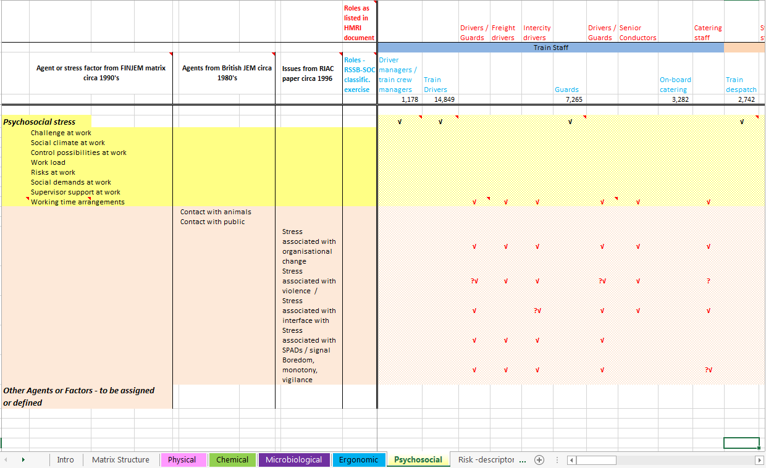
Snapshot of a rail risk matrix

Slide 10
Some ideas – from a simple risk matrix
Cold
Stress re. organisational change
Manual handling
DEEE
Workstress
Stress associated with violence / attempted suicide
Heat
Stress associated with SPADS
Knackered knees
Other organic dust
Boredom, monotony, vigilance

Slide 11
Some ideas – from general discussions
Trauma from working on the railway (Abuse, Witness to an incident)
Measurements of tools Vibration/Noise against manufacturing specifications
MSDs from prolonged exposure to walking on ballast
Shiftwork and cancer
Synergistic effects of known chemicals used within rail
Others?

Slide 12
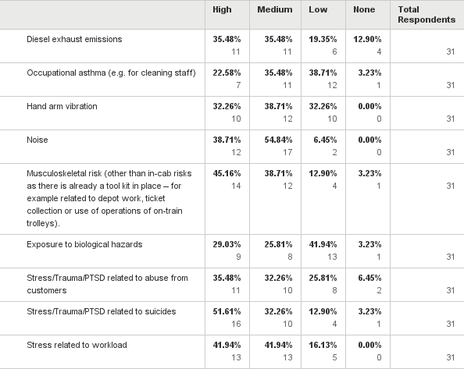
ATOC Survey – 31 respondents Q1: From the list of complex health hazards below, please indicate the level of focus you think there should be for each one i.e. high, medium, low or none at all. Please add any extra hazards that you think should be included where indicated below
Health Hazards | Rank H | Rank M
DEEE | 5 | 5
Occupational Asthma |  | 5
HAVS |  | 3
Noise | 4 | 1
MSD | 2 | 3
Biological Hazards
Stress/Trauma/PTSD – abuse | 5
Stress/Trauma/PTSD - Suicides | 1
Stress related to workload | 3 | 2
Notes:
Link Stress/Trauma/PTSD
Helps us consider what to rule out?

Slide 13
ATOC Survey – Free text responses
With the potential for a significant increase in OHLE installations across the network and the upcoming regs on EMF coming into force I believe we need to be on the front foot with this
Musculoskeletal risks associated with manual handling (particularly for infrastructure work)
Fatigue Management The classic dichotomy of pressure to perform (and deliver results i.e. trains on time) versus necessity to perform safety
Fatigue and rostered work Sedentary workload and lack of nutrition and hydration rostered work. Biggest reason for anxiety stress and depression and biggest cause of absence in TOC is life and a lack of personal resilience
fatigue RSI
risk of developing endocrine disorders (e.g. diabetes)
Substances hazardous to health

Slide 14
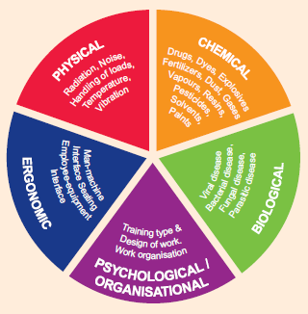
Some general health hazards

Slide 15
Beneficial Impact
Most beneficial impact is currently understood as:
Information supports the management of a health risk – it is better to manage the significant risks
Information fills a clear need and offers clear benefits within rail companies
Clearly sets out new and additional information not yet delivered by industry companies
Benefits a large number of workers to improve their health or significantly improves the health of a few individuals
Findings can be used by a large number of rail companies

Slide 16
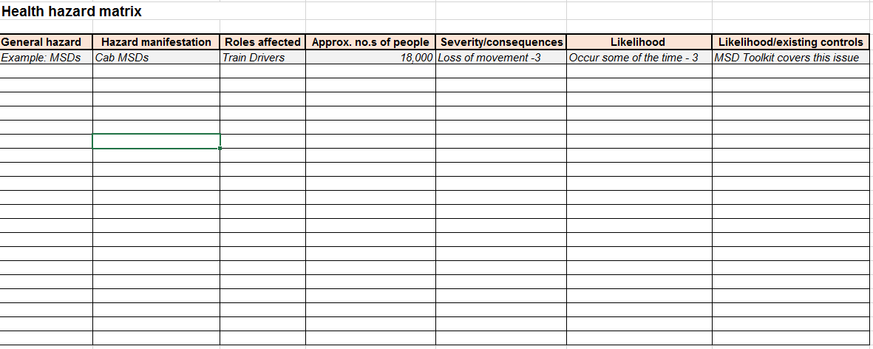
A list of hazards

Slide 17
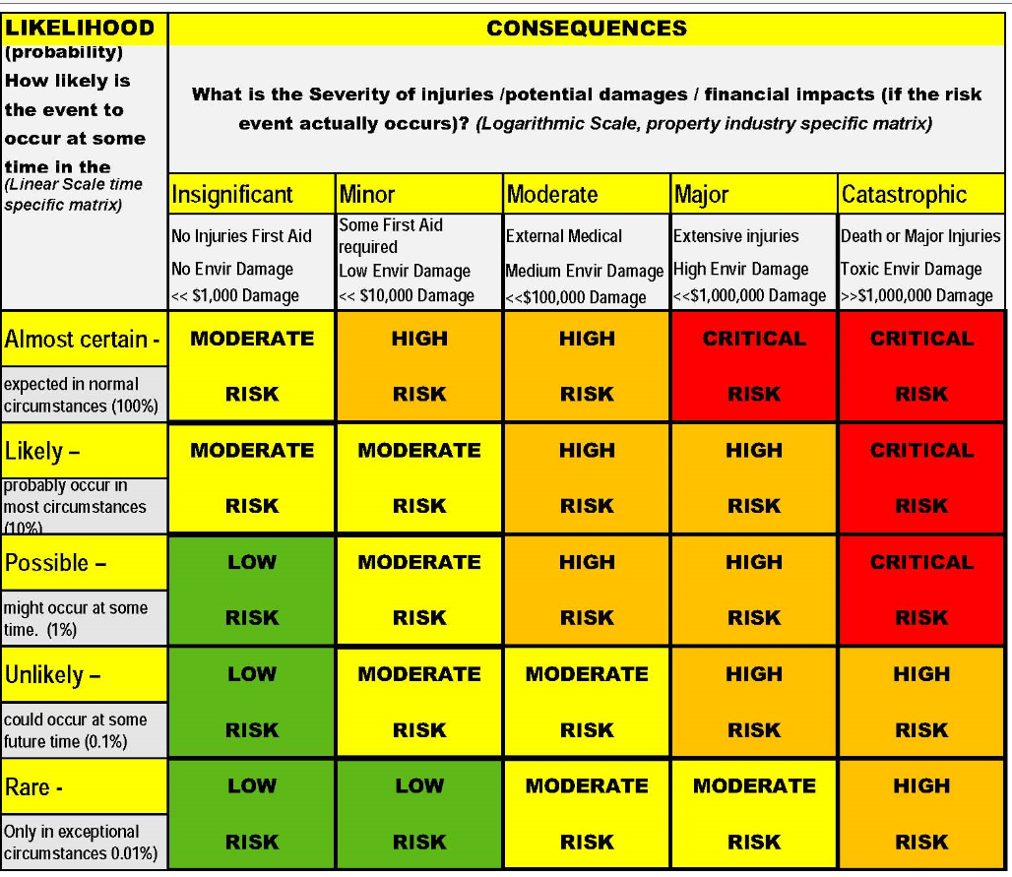
Risk Matrix

Slide 18
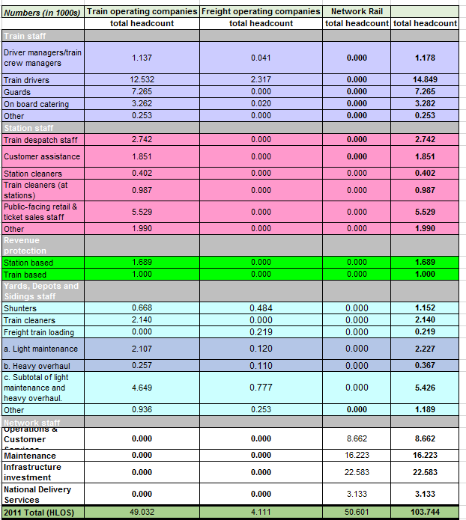
HLOS Figures

Slide 19
Structured 1:1
Each supplier is allocated a 15 minutes time slot to comment on the specification and for us to discuss the pricing model.

Slide 20
Open Floor
Any other questions?

Slide 21
Thank you

