Slide 1
Registering on the Attain portal and Applying for a tender
BravoAdvantage 16 Userguide
August 2017

Slide 2
Advert and Registering
All opportunities will be advertised via the Contracts Finder website for transparency purposes
  https://www.gov.uk/contracts-finder
Providers will be directed to the E-Bravo tendering portal:
https://attain.bravosolution.co.uk/web/login.html
  Allows communication which ensures all parties are given the same opportunity to compete ‘level playing field’;
  Creates a strong audit trail and faster communication
  Reduced paperwork and costs

Slide 3
Bravo Video Link
more.bravosolution.com/uk/bravoadvantage/guidance-for-suppliers?utm_campaign=UK_2015_BravoAdvantage_Comms&utm_medium=email&_hsenc=p2ANqtz--

Slide 4
Bravo E-Tendering System
Bravo Sourcing Helpdesk:
Phone: 0800 368 4850
E-mail: help@bravosolution.co.uk
A simple, secure and efficient way of managing tendering activities while reducing the time and effort required for both commissioners and providers

Slide 5
AQP Questions and Service Specification
Use the Service Specification
Read each question and bullet points
Ensure the right person is answering the questions
Do not leave it last minute to complete the questions

Slide 6
Getting Started
A Contract Finders or an Official Journal of European Union (OJEU) Notice will ask you to register and obtain the tender documents for any procurement run on the Attain e-tendering Bravo Portal.
You must register your organisation if not already registered.
You will be required to do this only once.
Please note that all information submitted via this portal is strictly secure and restricted to the Attain Procurement Team.

Slide 7
Types of tenders on Bravo
Pre-qualification questionnaire – PQQ
  This can also be Market Engagement or Request for Information (RFI)
Invitation to Tender – ITT
  This can also be an Invitation to Quote (ITQ)
Any qualified Provider (AQP)

Slide 8
Services to apply for
Non-Scalpel Vasectomy services

Slide 9
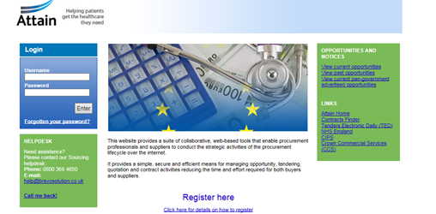
Registration
To register with the Attain E-Tendering portal:
  Click on link below for the portal
  https://attain.bravosolution.co.uk/
  2. From the portal Home Page, click the ‘Click Here to Register’ link

Slide 10
Registration
  Accept the terms & conditions for using the portal
  Complete your organisation & personal details
  Choose a memorable username and submit
  You will then be sent an email with your unique password, please treat this securely (if you lose it there is a ‘Forgot my Password’ link on the portal homepage
To Note: Once you have registered, there is an option ‘Help for suppliers for any stage of the process’
Important Note: Any AQP processes are always uploaded as an ITT (Invitation to Tender)

Slide 11
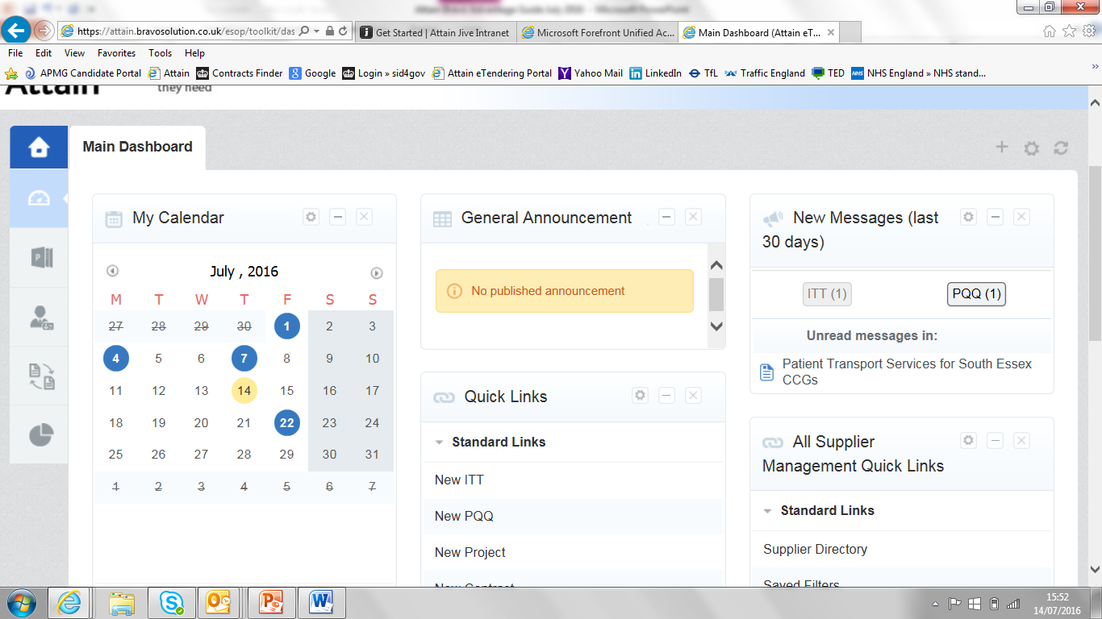
Finding your PQQ/ITT/AQP
1.You will land on the Main Dashboard which looks like this:
2.Always use the home Key to go back to the dashboard.

Slide 12
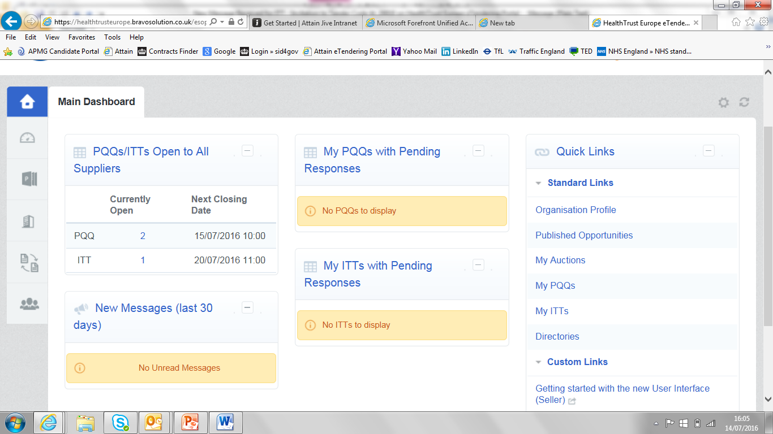
Finding your PQQ/ITT/AQP 2.Navigate to PQQs/ITTs Open to all Suppliers (note AQPs are under ITT)

Slide 13
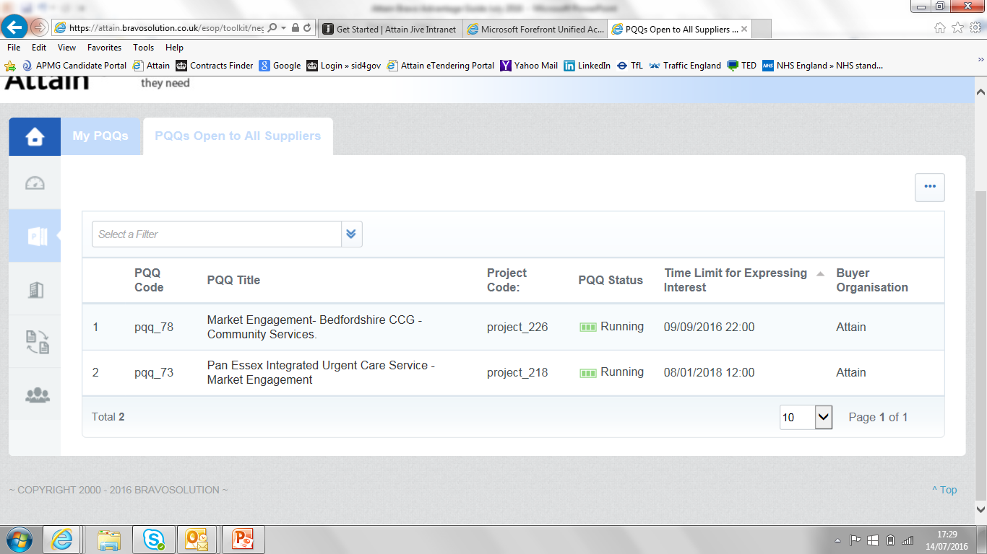
Finding your PQQ/ITT/AQP 3. Click on PQQ or ITT and then click on the name of the tender you are interested in

Slide 14
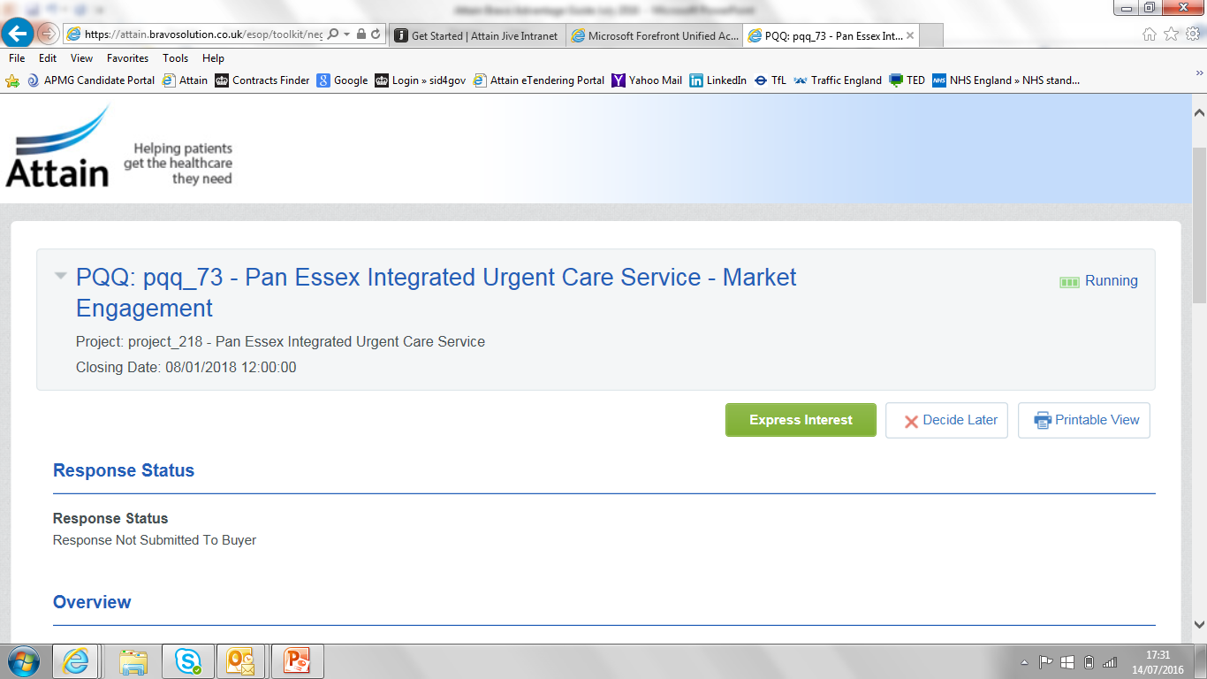
Finding your PQQ/ITT/AQP 4. Then click on Express Interest

Slide 15
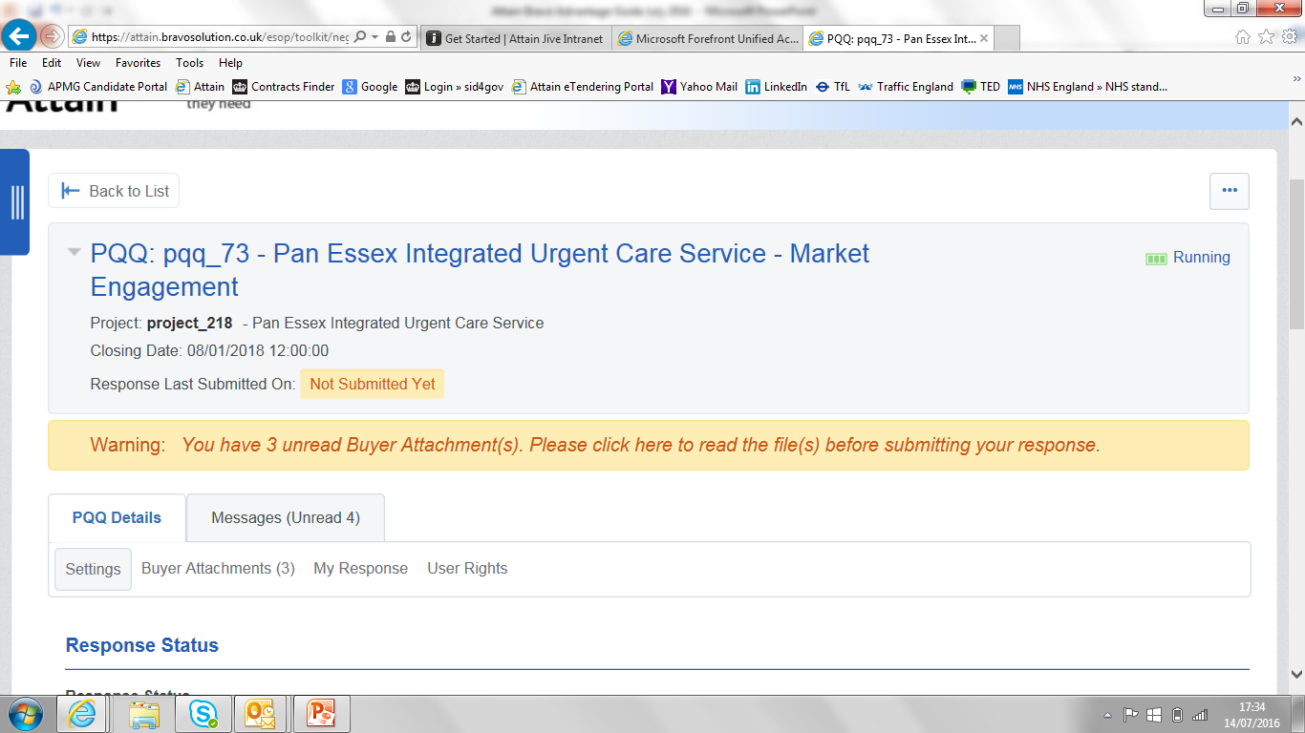
Finding your PQQ/ITT/AQP 5. Once you Express Interest, you will be able to download the documents by clicking on the message or clicking on “Buyer Attachments”

Slide 16
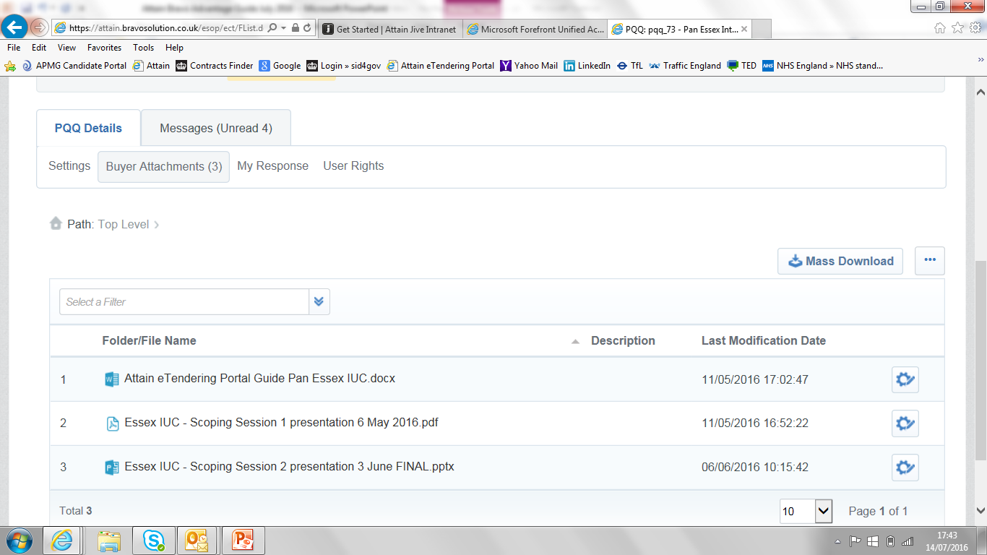
Downloading Documents 6. After clicking on message you can see the document list which you can download individually by clicking on their names or use “Mass Download” to get all documents in one go

Slide 17
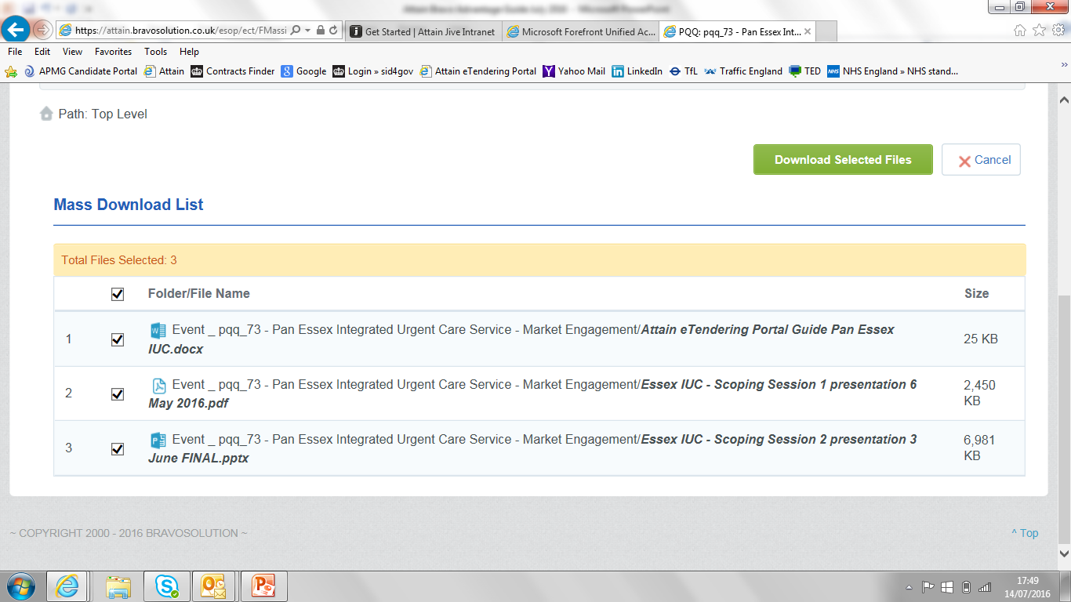
Mass Downloading 7. Files are already selected so you click on the green button

Slide 18
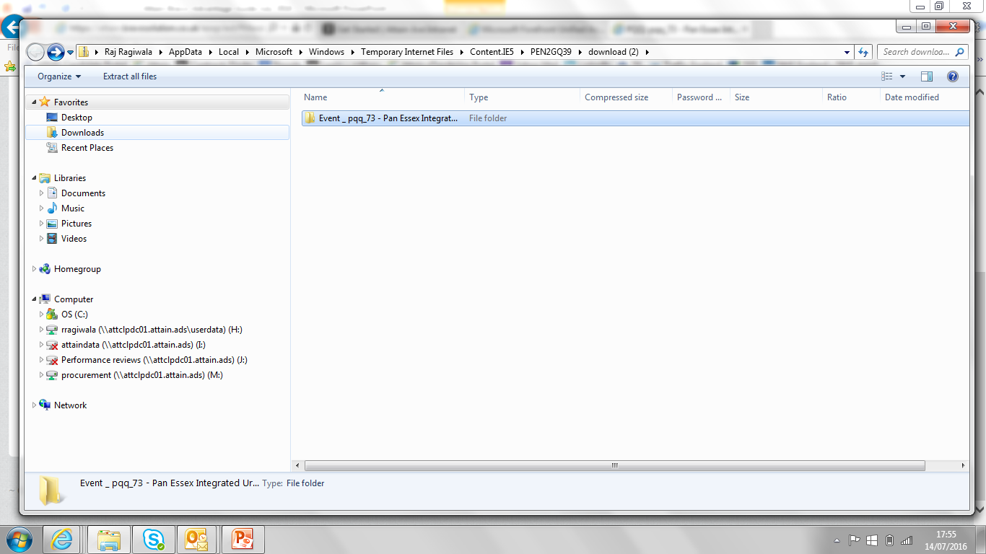
Mass Downloading 8. Files are downloaded in a folder and double click to see the document

Slide 19
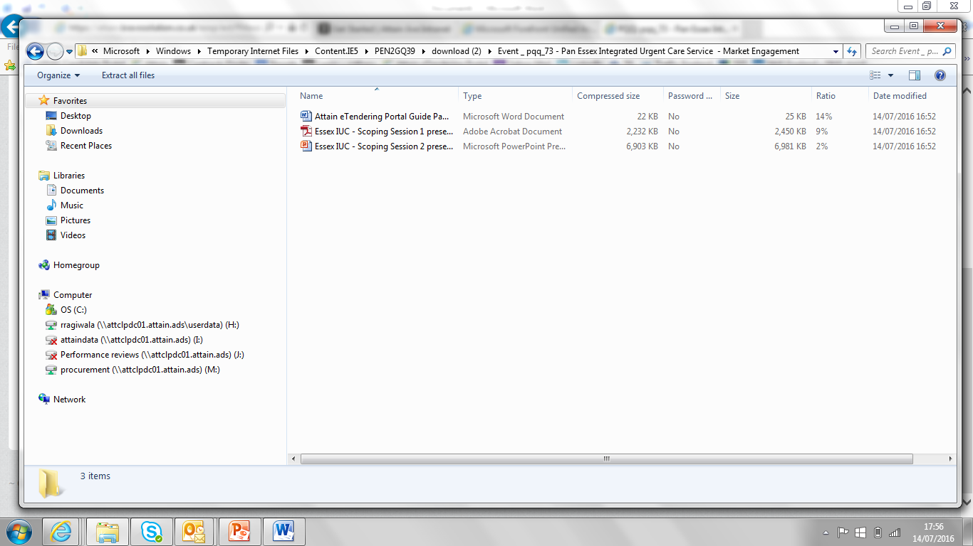
Mass Downloading 9. Save these files on your computer and then on Bravo cancel the mass download to get back to the PQQ or ITT Screen. You can now answer the questions in the word document and return to Bravo to submit your bid.

Slide 20
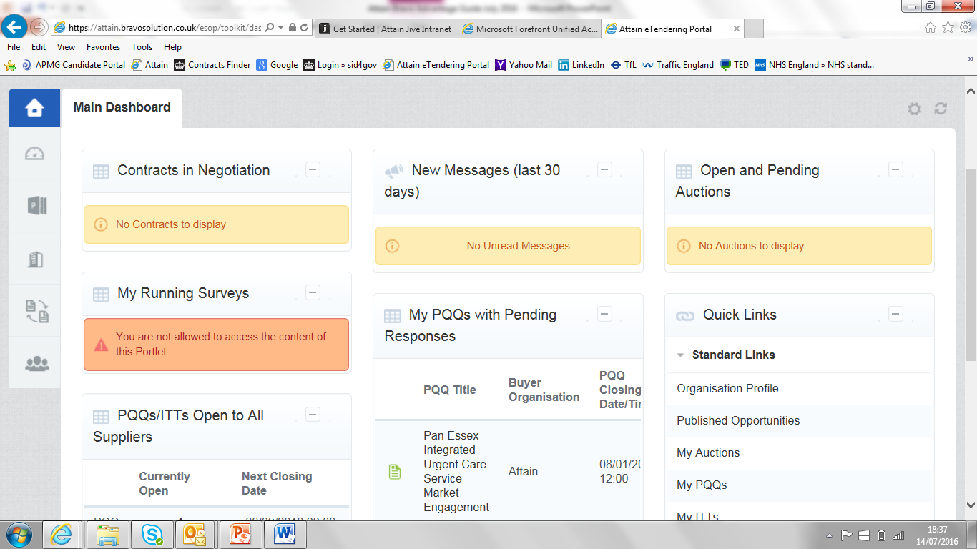
Submitting your response 10. When you return to Bravo, you can access the tender from My PQQs or if it is an ITT – My ITTs from the main Dashboard. Click on name

Slide 21
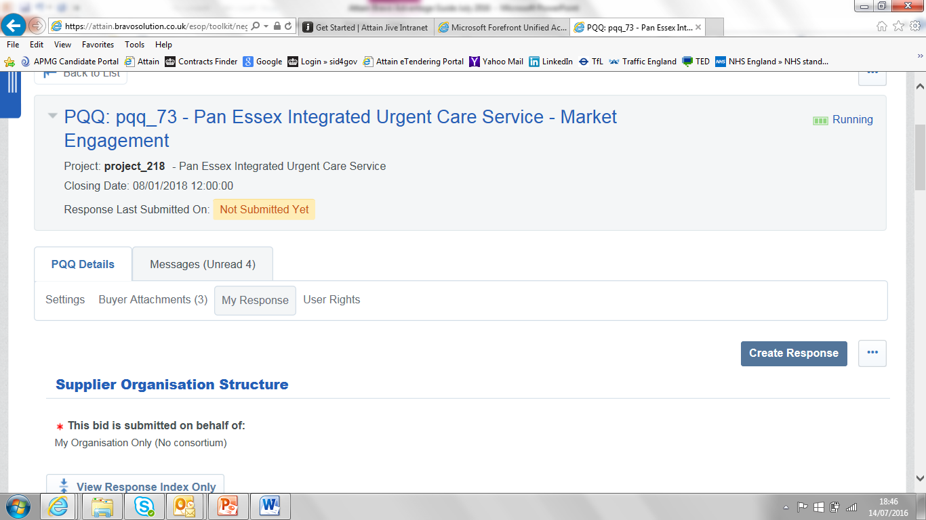
Submitting your response 11. Clicking on name will take you into the My Response and the standard questions will show further down to complete on-line by clicking on Create Response

Slide 22
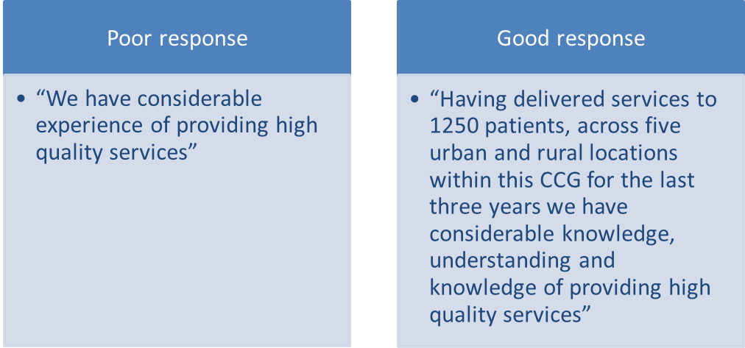
Good and Bad Examples
Examine the Scoring Matrix. What does a 2 out of 5 look like?
What does a 4 out of 5 look like?

Slide 23
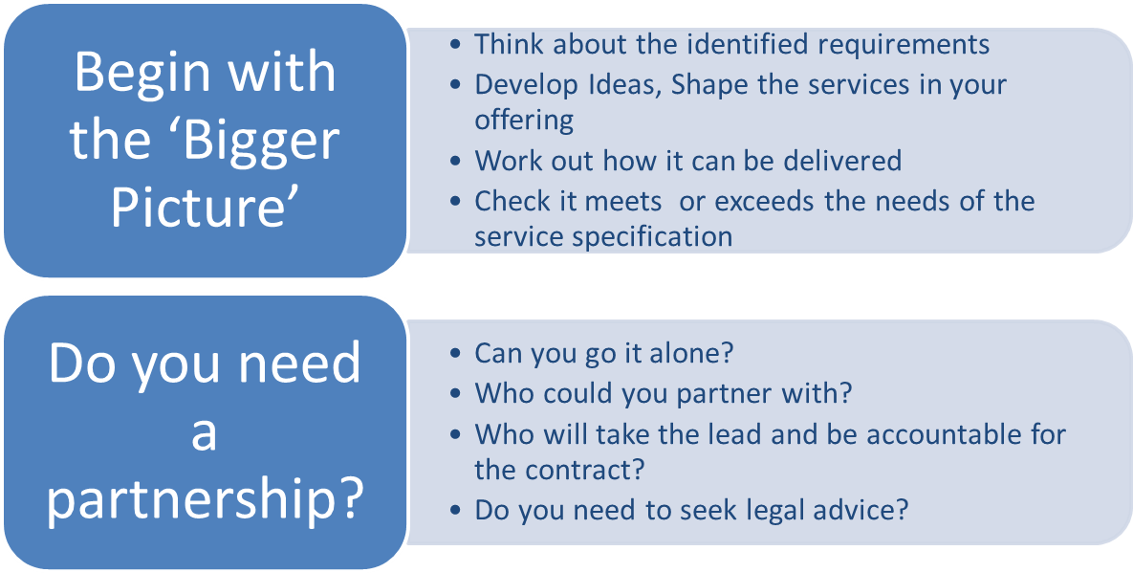
What to do

Slide 24
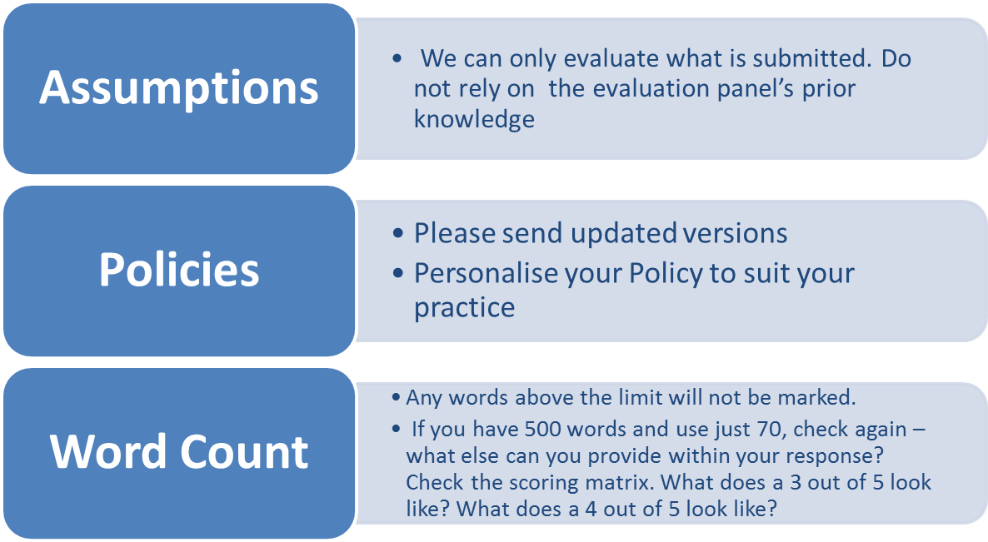
What to do

Slide 25
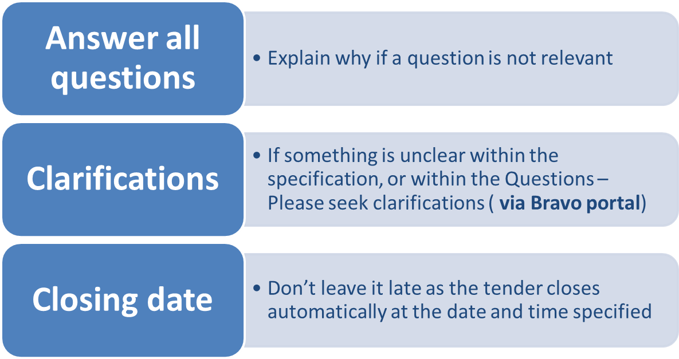
What to do.

Slide 26
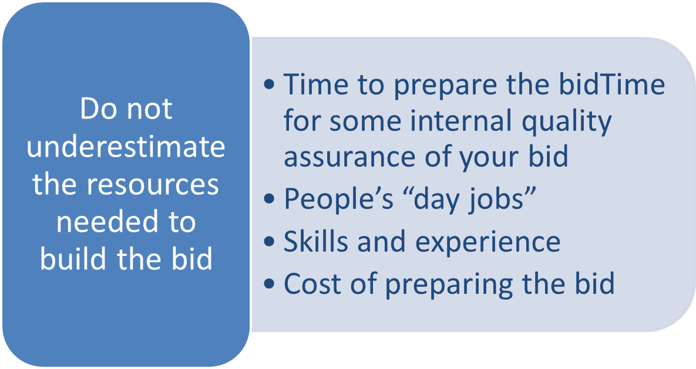
What not to do

Slide 27
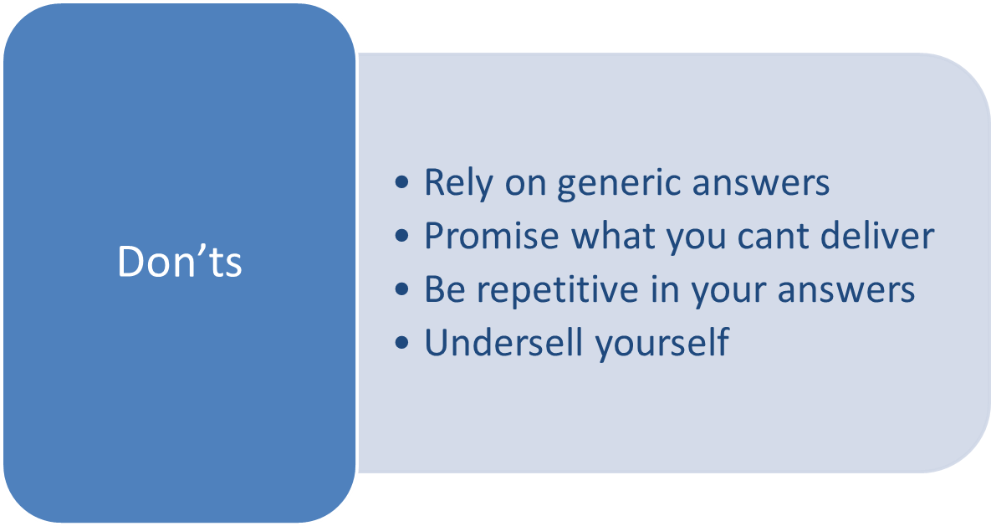
What not to do

Slide 28
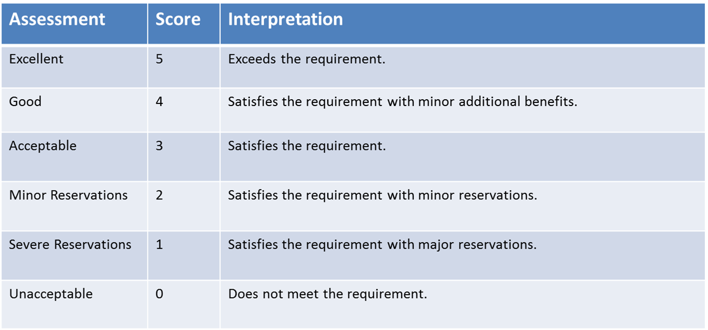
Scoring

Slide 29
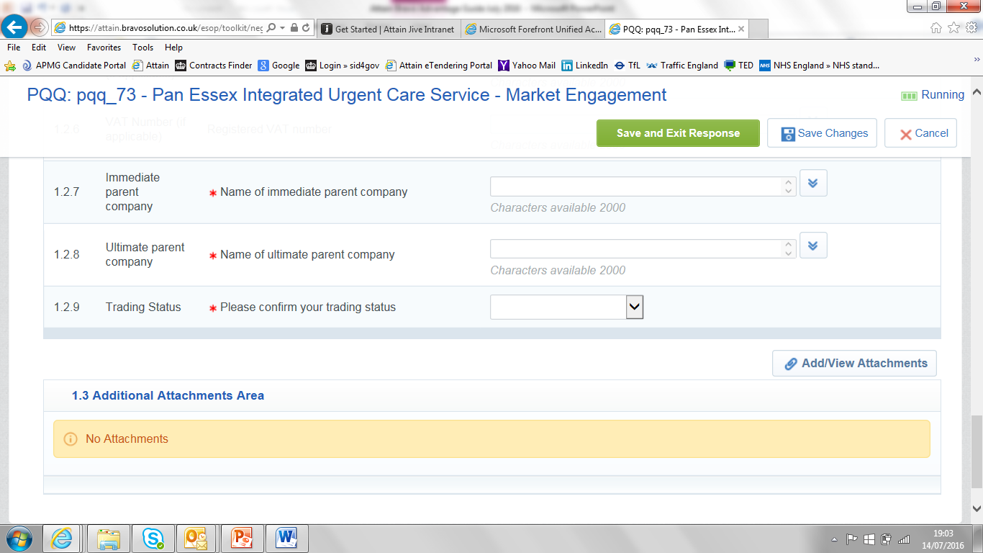
Uploading your response documents 12. Once you have answered the questions (some answers require uploading of an attachment and the option is next to the question). There is also a general area where you can upload any other documents required for this tender using Add/View Attachments

Slide 30
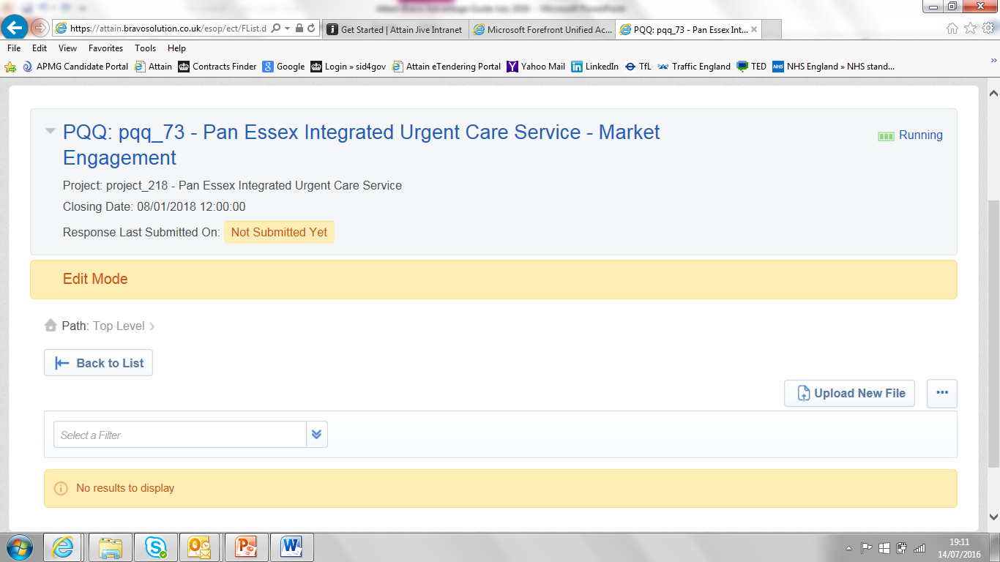
Uploading your response documents 13. Add/View Attachments will bring you to this screen where you can click on Upload New file
14. Click the back button to go back a page to ensure you do not lose your work

Slide 31
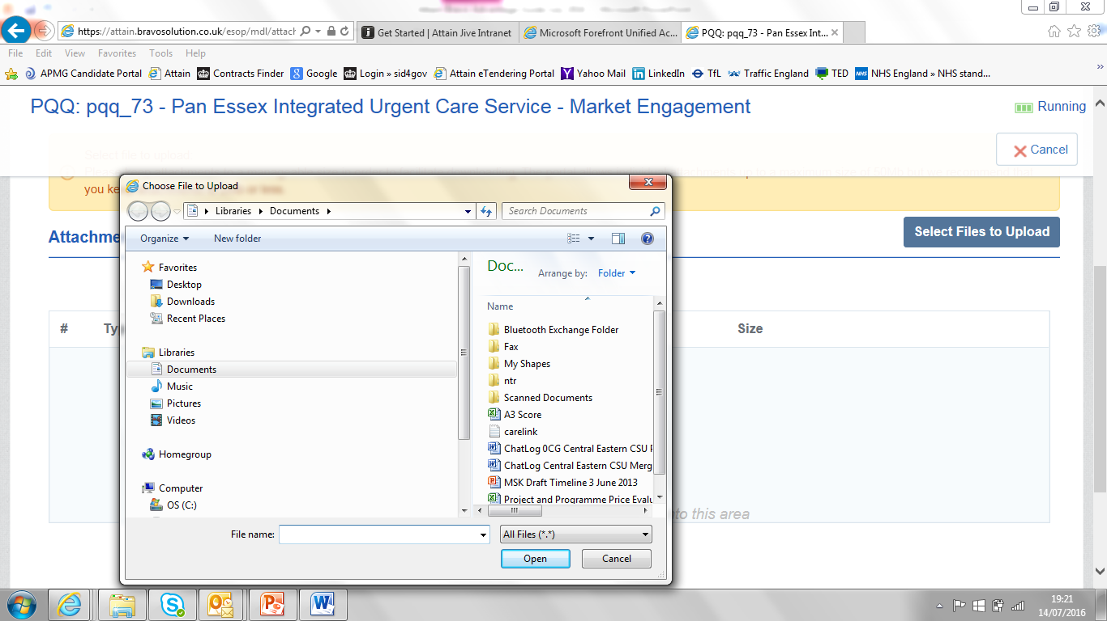
Uploading your response documents 14. Then Click on Select Files to Upload, choose the file from your PC that you want to upload and then Confirm Upload. You can than choose to upload another file or select Save All to save all the files added so far. Note that the files are only uploaded into Bravo when you click on Save All.

Slide 32
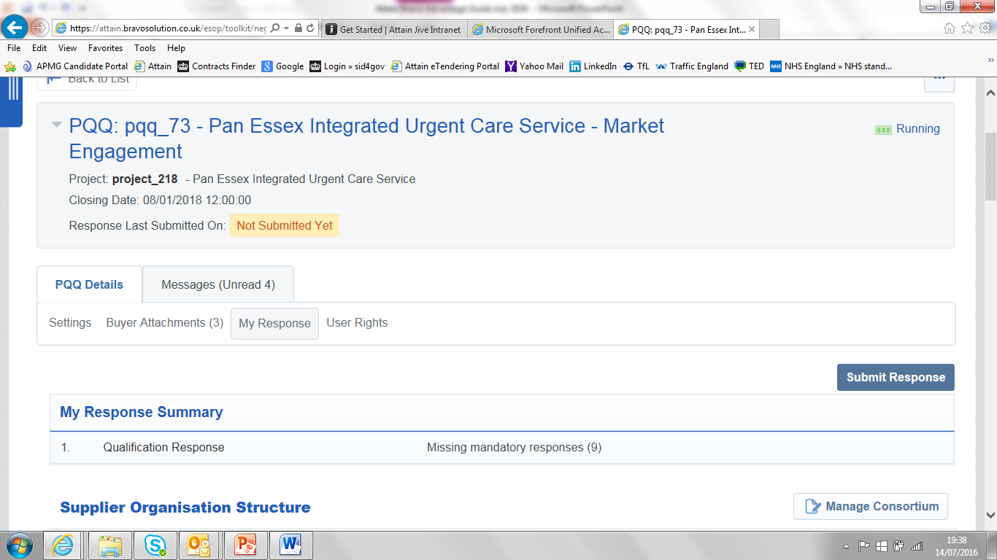
Final submission of your response 15. Once your response is complete you can select Submit Response, you are still able to change your response as many times as you need until the closing date and time. Each time you will need to re-submit your response.

Slide 33
Summary & Next Steps
Registering on Contracts finder / Bravo
Sign up now / activate your account
Scoring matrix (0-5)
Communication via Bravo portal only
No direct contact can be made with procurement team once bids are put out
Referring to service specification when answering questions
Use templates as a guide to check your policies
Breaking question down to ensure you are answering key areas
Timeline and deadlines
Do’s and Don’ts
For further information or assistance please contact the Bravo Helpdesk on:
Tel: 0800 368 4850
E-Mail: help@bravosolution.co.uk

Slide 34
Esther Pettigrew
Esther.Pettigrew@attain.co.uk
07554 437503

